Slide 1

EDA ON GOA’s HOLIDAY HOMES
NAME:- YOGI AADESHKUMAR
BATCH:-450

Slide 2
Agenda
Business Problem
Tools Used
Scraping
Data Preprocessing and Cleaning
Dataset Overview
Univariate Analysis
Bivariate Analysis
Multivariate Analysis
Hypothesis Testing
Insights & Recommendations
Conclusion
Q&A

Slide 3
Business Problem
New and emerging property owners often find it difficult to decide the right pricing for their villas and apartments. A poorly chosen price can either reduce customer interest or negatively impact ratings, making it challenging to balance reputation and revenue.
Business Objective
The objective of this analysis is to assist new property owners in identifying an optimal pricing range that helps maintain positive customer ratings while ensuring stable and sustainable revenue growth.

Slide 4
Problem Statement
Setting the right price is a key challenge for new property owners, as overpricing can reduce ratings while underpricing may lower revenue. This analysis examines the relationship between pricing and ratings to support better pricing decisions.

Slide 5
Scraping
Libraries Used & Their Purpose
To analyze property prices, property types, and market trends in Goa Holiday homes, the following Python libraries were used to collect and process structured data from online property listing platforms.
Selenium-Automated browser interaction
BeautifulSoup (bs4)-Parsed HTML content retrieved from Selenium
Scraping Process
Identified listing card containers from the website structure
Extracted key attributes such as:
  Property_Name
  Location
  Property_Type
  Room_Type
  Price
  Rating
  Reviews
  Free_Cancellation

Slide 6
Data Preprocessing &Cleaning
Libraries Used & Their Purpose
Pandas-Data storage, cleaning, transformation, and validation
NumPy-Numerical operations and missing-value handling
Standardized schema and data types across property listings
Performed data quality checks (nulls, uniques, summary stats)
Extracted price and property details from text fields
Standardized units and handled missing values logically
Prepared a clean, analysis-ready dataset

Slide 7
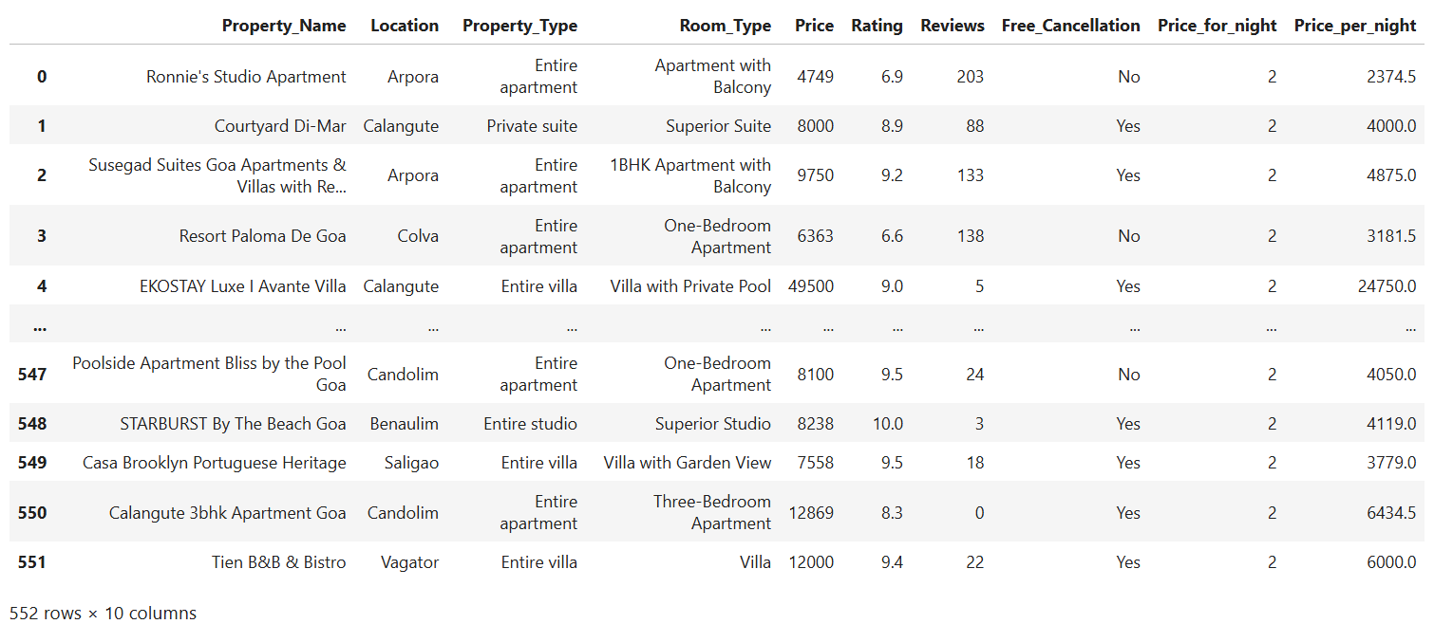
Dataset Overview
The final cleaned dataset contains
  552 rows and 10 columns
Key Columns & Description
Project_Name – Name of the Property
Location – Area in Goa
Property_Type – Type of property (Apartment, Villa)
Room_Type – Features of room
Price – Numeric listing price
Rating – Rating of property out of 10
Reviews– Reviews of property
Free_Cancellation– Free cancellation available or not

Slide 8
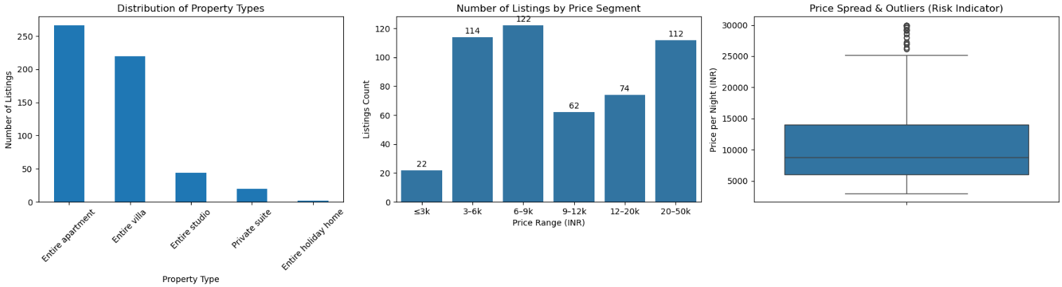
Uni-Variate Analysis
Goa’s holiday home market is dominated by entire apartments and villas, with most listings priced in the mid-range and a few high-priced outliers.

Slide 9
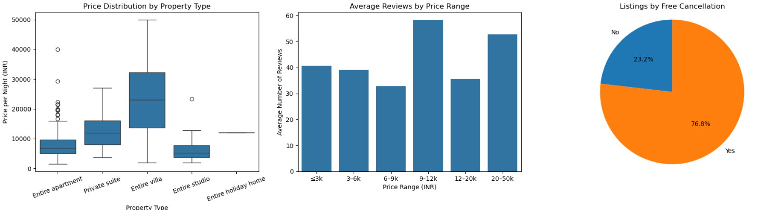
BI-Variate Analysis
Goa’s holiday home market shows higher pricing for villas, mid-range listings attract more reviews, and free cancellation plays a key role in listing availability.

Slide 10
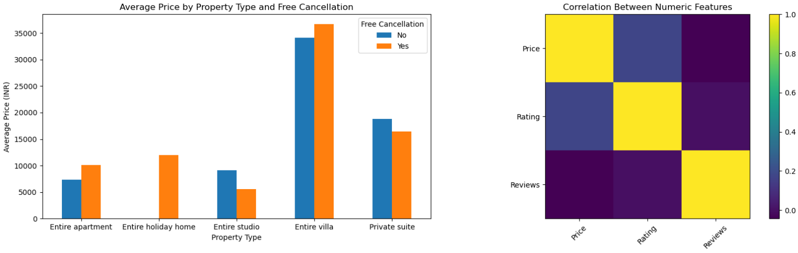
Multi-Variate Analysis
Villas and private suites command higher prices, free cancellation slightly influences pricing, while price shows weak correlation with ratings and reviews.

Slide 11
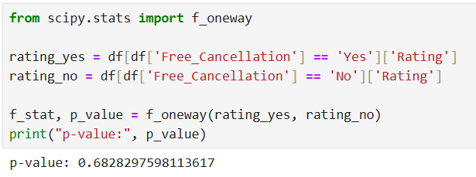
Hypothesis Testing
Two variables: Categorical vs Numerical
Research Question
  Does offering free cancellation have an impact on customer ratings?
Hypotheses
  H₀ (Null Hypothesis): Free cancellation has no effect on customer ratings.
  H₁ (Alternative Hypothesis): Free cancellation has a significant effect on customer ratings.
Test Used
  One-way ANOVA
P-value : 0.6
Interpretation
  The p-value is greater than 0.05, so free cancellation does not significantly affect customer ratings.

Slide 12
Recommendations
Key Insights
Entire apartments and villas dominate the market supply.
Mid-priced properties receive higher guest engagement and reviews.
Villas and private suites are positioned as premium offerings.
Focus more on apartments and villas for better demand.
Keep prices competitive in the mid-range to attract guests.
Offer free cancellation to increase booking chances.

Slide 13
Conclusion
The market is mainly driven by apartments and villas.
Most properties are priced in the mid-range and get more bookings.
Villas are costlier, while ratings and reviews have little effect on price.
Free cancellation is common but has limited influence on pricing.
Ratings and reviews show weak correlation with price.

Slide 14


Slide 15


